Slide 1
Molveno Resort: Restaurant Application Project planning/approval
Reykjavikplein 1 Utrecht, 14-09-2018, Team Capricornus

Slide 2
Team Capricornus Voorstelronde
Remco De Koeijer
Jeroen Hagen
Youssef Jabbar
Hans van Os
Jasper Fennet

Slide 3
Inhoudsopgave
Voorstelronde
Globale Scope project
Werkwijze software ontwikkeling Capgemini
Bespreken vervolgcontact.
Vragen

Slide 4
Global project scope project Resort Molvena: Restaurant Applicatie
Eigenaar
Insert Role Picture here.

Slide 5
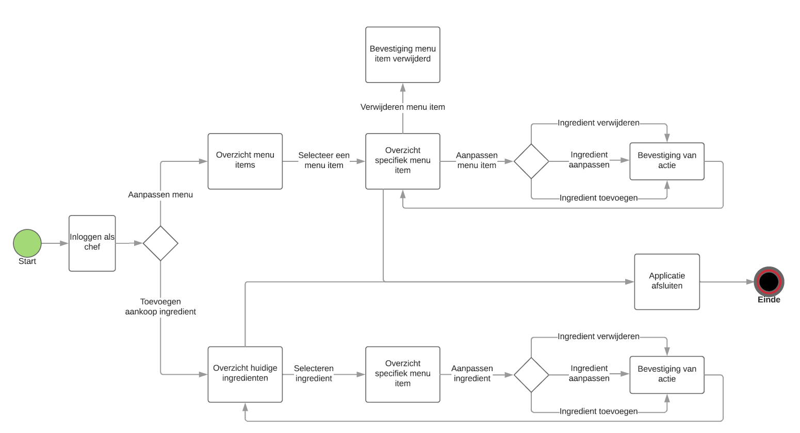
Global project scope Resort Molvena: Restaurant Applicatie
Chef-Kok/Sous-Chef

Slide 6
Global project scope project Resort Molvena: Restaurant Applicatie
Floor manager
Insert Role Picture here.

Slide 7
Schatting Restaurant Application Resort Molvena
60%
30%
10%
Content management
Verwerken
Authenticatie
Tafels
Reserveringen
Ingredienten
Menu’s
Gasten
Marges(Kostprijs v Omzet)
Wensen Gasten
Login/Registreren
Rolemanagement
Security

Slide 8
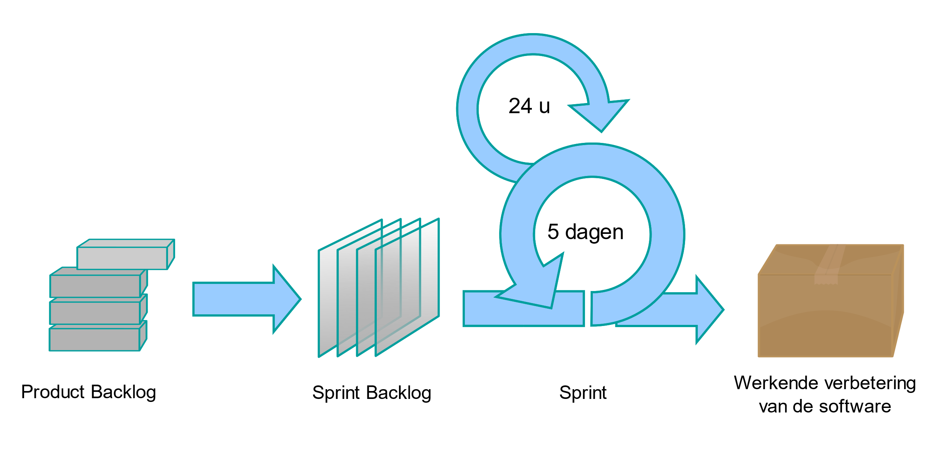
Projectmethode Capgemini Agile

Slide 9
Vervolgcontact

Slide 10
Title (Work for 1 or 2 lines of title)
Header
Header
Header
First level
Second level
Third level
Fourth level
Fifth level
First level
Second level
Third level
Fourth level
Fifth level
First level
Second level
Third level
Fourth level
Fifth level

Slide 11
Title (Work for 1 or 2 lines of title)
Header
Header
Header
First level
Second level
Third level
Fourth level
Fifth level
First level
Second level
Third level
Fourth level
Fifth level
First level
Second level
Third level
Fourth level
Fifth level
Header
Insert bullet point
Insert bullet point
Insert bullet point
Insert bullet point

Slide 12
Title (Work for 1 or 2 lines of title)
Header
Header
Header
Insert bullet point
Insert bullet point
Insert bullet point
Insert bullet point
Insert bullet point
Insert bullet point
Insert bullet point
Insert bullet point
Insert bullet point
Insert bullet point
Insert bullet point
Insert bullet point

Slide 13
Title (Work for 1 or 2 lines of title)
Insert name Insert Title/Role
Insert bullet point
Insert bullet point
Insert bullet point
Insert bullet point
Insert name Insert Title/Role
Insert bullet point
Insert bullet point
Insert bullet point
Insert bullet point
Insert name Insert Title/Role
Insert bullet point
Insert bullet point
Insert bullet point
Insert bullet point
Insert name Insert Title/Role
Insert bullet point
Insert bullet point
Insert bullet point
Insert bullet point

Slide 14
Title (Work for 1 or 2 lines of title)
1
Subtitle
 | TEXT | TEXT | TEXT | TEXT | TEXT | TEXT | TEXT
TEXT | Text sample | Text sample | Text sample | Text sample | Text sample | Text sample | Text sample
TEXT | Text sample | Text sample | Text sample | Text sample | Text sample | Text sample | Text sample
TEXT | Text sample | Text sample | Text sample | Text sample | Text sample | Text sample | Text sample
TEXT | Text sample | Text sample | Text sample | Text sample | Text sample | Text sample | Text sample

Slide 15
Title (Work for 1 or 2 lines of title)
Click to insert chart title
Click to insert chart title
Click to insert text
Click to insert text

Slide 16
Title (Work for 1 or 2 lines of title)
1
2
3
4
5
6
7
8
9
10
11
Text sample
Text sample
Text sample
Text sample
Text sample
Text sample
Text sample
Text sample

Slide 17
Title (Work for 1 or 2 lines of title)
Click to insert chart title
Click to insert chart title

Slide 18
Title (Work for 1 or 2 lines of title)
Click to insert title
Click to insert title
Click to insert title
Click to insert title
Click to insert title
Click to insert bullet point
Click to insert bullet point
Click to insert bullet point
Click to insert bullet point
Click to insert bullet point
Click to insert bullet point
Click to insert bullet point
Click to insert bullet point
Click to insert bullet point
Click to insert bullet point
Click to insert bullet point
Click to insert bullet point
Click to insert bullet point
Click to insert bullet point
Click to insert bullet point

Slide 19
Title (Work for 1 or 2 lines of title)
XX%
XX%
XX%
XX%
Click to insert text
Click to insert text
Click to insert text
Click to insert text
XX%
Click to insert text

Slide 20
Title (Work for 1 or 2 lines of title)
Insert Group Name
Click to insert bullet point
Click to insert bullet point
Click to insert bullet point
Insert Group Name
Click to insert bullet point
Click to insert bullet point
Click to insert bullet point
Insert Group Name
Click to insert bullet point
Click to insert bullet point
Click to insert bullet point
Group Name
Click to insert text
Click to insert text
Click to insert text
Click to insert text
Click to insert text

Slide 21
Icons

Slide 22
Graphic elements

